Slide 1
LECTURE 6
User Interface

Slide 2
Super Quiz - UI
What is a Shell Interface?
  The system Shell petrol stations use
  The main menu of a restaurant
  The main menu of a game
  The interface designed like a tortoise shell
  The USB system snails use

Slide 3
Super Quiz - UI
What is a button?
  That thing on my shirt that keeps my hairy chest safe
  That thing on my pants that keeps me from jail
  Anything I can click on
  Something I can click on
  A specific graphic that is interactable

Slide 4
Super Quiz - UI
What is a user interface?
  A way to guide user interactivity
  A way for machines and humans to communicate
  A way to multiply input
  A way to present output
  A way for U and I to face each other.

Slide 5
Overview
The role of User Interfaces
Types of User Interface controls
OO User Interface
Key User Interface Concepts

Slide 6
The Role of UI
To be interactive, a game has to respond to the player, the player then responds to the game, and so on.
  Without this interactivity, it’s not a game.
UI is not just buttons and windows and little icons.
It is the communication pipeline between the player and the game, and vice versa.
It is perhaps the most important aspect of your game.
But if you trivialized your UI system, you might as well just quit and go into film school.

Slide 7
The Role of UI
UI also plays a very important part in multiplying the possibilities of user input given a limited hardware interface
In example, a simple touchscreen can be made to do many many actions given a proper UI.

Slide 8
Types of UI Controls
Only two main types:
  Buttons - provides the user a simple way to trigger an event
  Labels - displays information on screen
Buttons and labels are just names in concept, but can be used for a lot more than just buttons and labels.

Slide 9
OO User Interface
What if you have many types of UI screens
  Main menu
  Options menu
  Load and save game menu
  In game menu
  Etc
What is the best way to maintain all the UIs yet maintain an OO concept?

Slide 10
OO User Interface – Poor design
Button buttons[10];
Label labels[10];
void setup() {
  for (int i = 0; i < 10; i++){
    buttons[i].setup();
    labels[i].setup();
  }
}
void update() {
  for (int i = 0; i < 10; i++) {
    buttons[i].update();
    labels[i].update();
  }
}
void draw() {
  for (int i = 0; i < 10; i++) {
    buttons[i].draw();
    labels[i].draw();
  }
}

Slide 11
OO User Interface – Poor design
Lacks maintainability
Lacks reusability
Generally wrong application of the OO concept

Slide 12
OO User Interface
Instead, we can create a master UI control that represents the entire screen
User Interface
Element
Button
Label

Slide 13
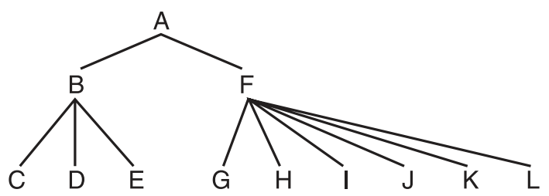
OO User Interface
Think of hierarchical trees

Slide 14
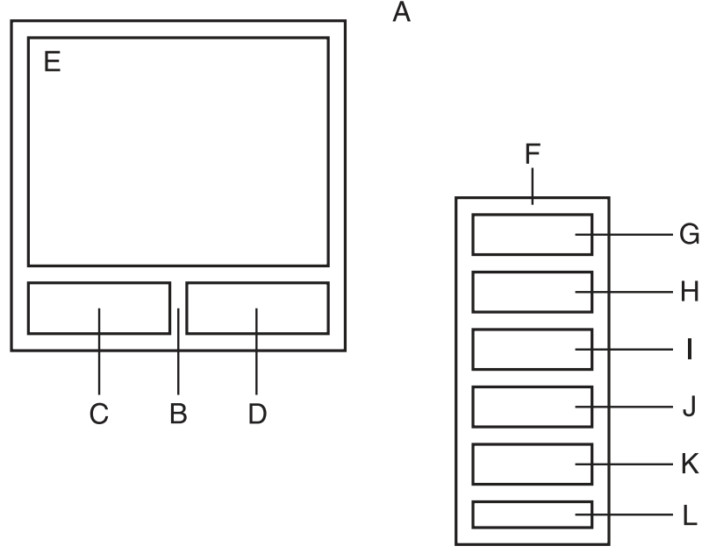
OO User Interface

Slide 15
Key Concepts
Z Ordering
UI events
  Notification - A common task for a widget is to notify its parent that some event has occurred.
  Focus - UI element that the user is interacting with at a given time.

